Slide 1
INCOME TAX ANALYSER USING TKINTER
NAME : HEMANTH KUMAR. B.
Reg.No : 212220040047
PROJECT GUIDE : DR. V. UMA RANI,Asso.Prof/CSE.

Slide 2
OVERVIEW:
Abstract
Objective
Literature Survey.
Existing System.
Proposed System.
System Architecture.
Modules.
Conclusion.
Future Enhancements.
Reference.

Slide 3
ABSTRACT:
To calculate a income tax of a salaried person
It creates the report of tax using old tax regime and new tax regime.
It helps the user to select the tax slab according to the report

Slide 4
OBJECTIVE:
Main Objective is to build a GUI application for Income tax Analyzer.
Income tax Analyser helps to manage their taxes and to choose best suitable tax regime(old or new)
To creates an opportunity to check how much they have opting tax system over the year
It creates a user friendly interface by giving brief idea to enter the details through images.
No-prior Knowledge is needed.

Slide 5
LITERATURE SURVEY.
“User-friendly Guidelines for Tax & Statutory Management in India”
According to Economic Survey 2015-16 the proportion of economically active population (15-59 years J has increased from 57. 7 % to 63.3 % during the 1991-2013 periods. The employment growth in the organized sector (public and private combined) increased by 2 %. Though huge numbers of people are working in India and they are paying their regular taxes by consulting financial experts but many of them are completely blank about the working and calculation of this part of their income. Considering this we decided to work on this topic and prepare user{friendly guidelines which can be referred by anyone. Examples have been cited for tax calculation related to salary. From the start to end process of the salary with taxation and statutory deduction will definitely help the working professional .

Slide 6
LITERATURE SURVEY.
“Tax Avoidance and the Deadweight Loss of the Income Tax” Traditional analyses of the income tax greatly underestimate deadweight losses by ignoring its effect on forms of compensation and patterns of consumption. The full deadweight loss is easily calculated using the compensated elasticity of taxable income to changes in tax rates because leisure, excusable income, and deductible consumption are a Hicksian composite good. Microeconomics estimates imply a deadweight loss of as much as 30% of revenue or more than ten times Harberger's classic 1964 estimate.

Slide 7
LITERATURE SURVEY.
“Single Window Performing Multiple Tax Operations”
The research paper deals with computerizing the process of tax payment. The entire process of tax payment will be maintained in an automated way. The main objective of this project is to reduce the time consumption. The income tax system has been categorized into three groups according to the mode of payment to the central government, state government, and the municipality.

Slide 8
EXISTING SYSTEM:
Online tool provided by income tax website for
calculating tax.
It helps to calculate the tax for the financial year.
It provides basic information for paying taxes.
They didn’t provide any comparison to old and new
tax regime.

Slide 9
PROPOSED SYSTEM:
The tool works completely offline and compare Old tax slabs and New tax slabs
Recommend which tax slab is better to follow.
Calculate how much tax have to pay for the financial year
It reduce time consuming and provide money saving.

Slide 10
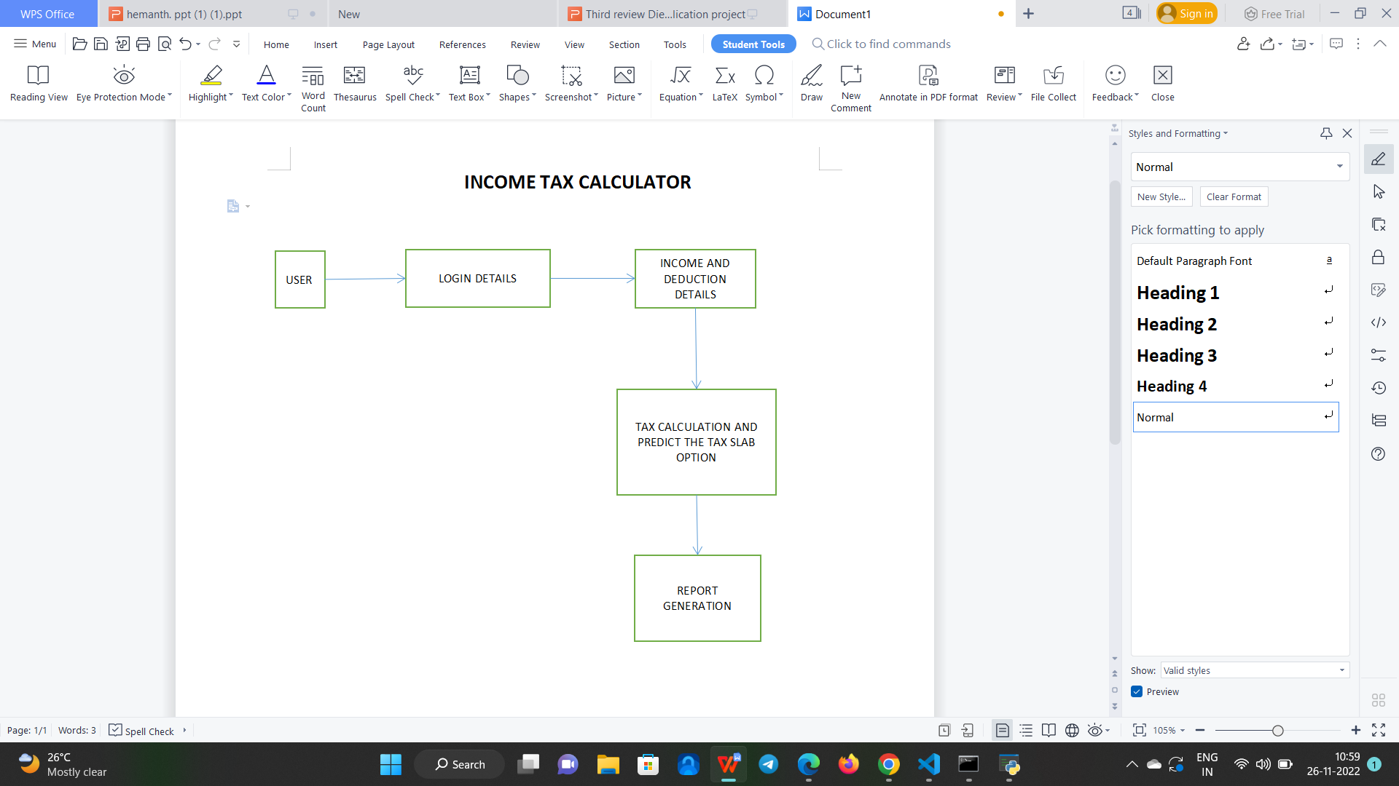
ARCHITECTURE:

Slide 11
MODULES:
USER LOGIN
INCOME AND DEDUCTION DETAILS
TAX CALCULATION
PREDICTION OF TAX SLAB
REPORT GENERATION

Slide 12
MODULE DESCRIPTION:
USER LOGIN
Creating user login interface for entering name,contact number,Gmail id
checking the entered details are in correct format or not
Providing reference to enter the details
INCOME AND DEDUCTION DETAILS
For Income textbox:
The user has to enter the sum of anuual income details
that is how much he earned throughtout the financial year
For Deduction textbox:
The user has to enter the sum of all deduction that occured throughtout the financila year

Slide 13
MODULE DESCRIPTION:
TAX CALCULATION
Calculating tax for each Tax slab according to the tax rate mentioned by income tax of india for income generated after removal deduction mentioned previously
PREDICTION OF TAX SLAB
After calculation of each tax slab and comparing both tax slab payable amount and predicting the tax slab which provides the low payable amount .

Slide 14
REPORT GENERATION
Generating a pdf report of calculation of tax slabs and mentioning the tax slab which is better to follow .

Slide 15
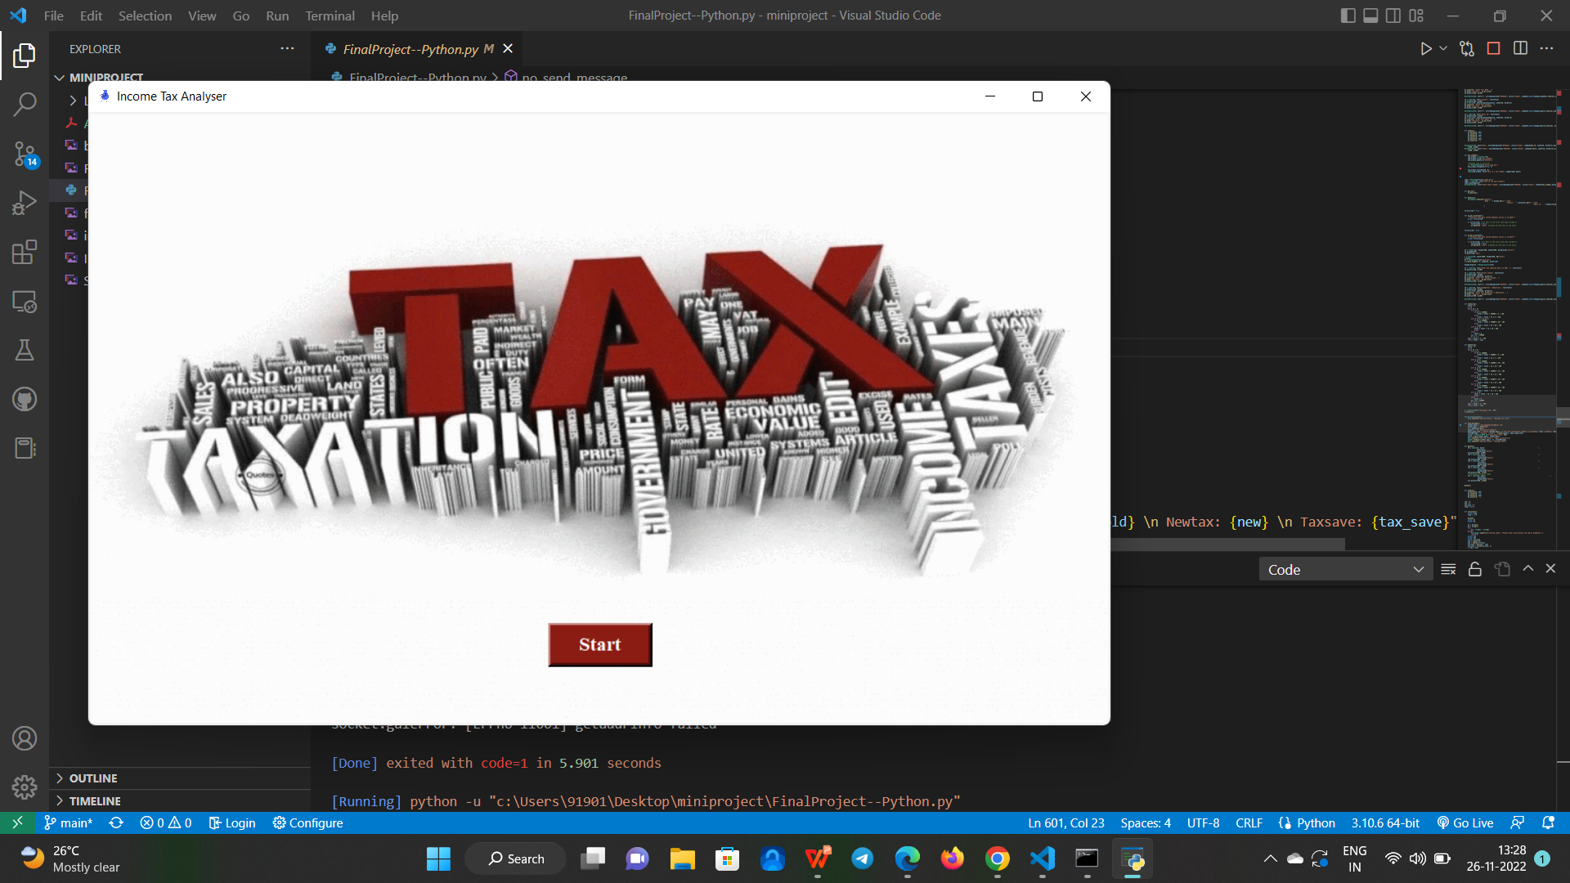
Screenshot of project:

Slide 16
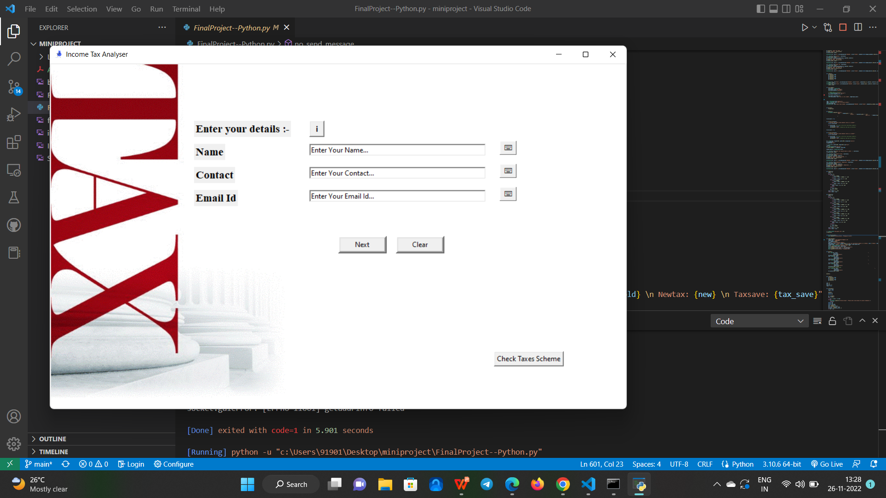
User Login Screen:

Slide 17
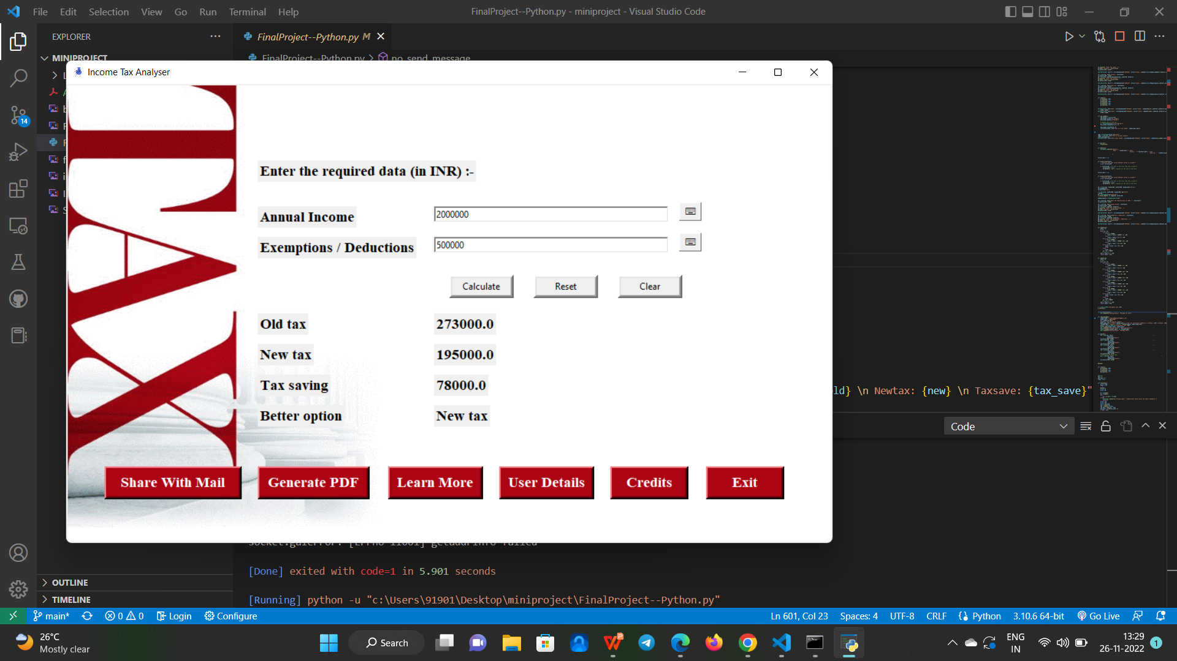
Income Tax Claculation and Slap:

Slide 18
CONCLUSION:
A simple GUI for income tax calculation is developed for users.
It helps to learn about income tax rules for filling the ITR.
It provide sugession to select tax slab over the income.

Slide 19
FUTURE ENHACEMENT:
In the future scope, the application can enhance its functionality by adding image recognition of deduction reports.
To analyze the report and concluding deduction is considerable or not.
Including an voice assistant to instruct for entering the details.

Slide 20
REFERENCE:
INCOME TAX OF INDIA.
https://www.incometax.gov.in/
Alm, J. (2012). “Measuring, Explaining, and Controlling Tax Evasion: Lessons from Theory.
Experiments, and Field Studies.” International Tax and Public Finance 19 (1): 54-77.
Lymer, A., and Oats, L. (2009). Taxation: Policy and Practice. 16th ed. Birmin Fiscal.
TKINTER DOCUMENTATION.

Slide 21
Thank you

